Slide 1
JDBC Connector
Notes:
This brief presentation walks through the setup steps for Databricks’ JDBC Connector.

Slide 2
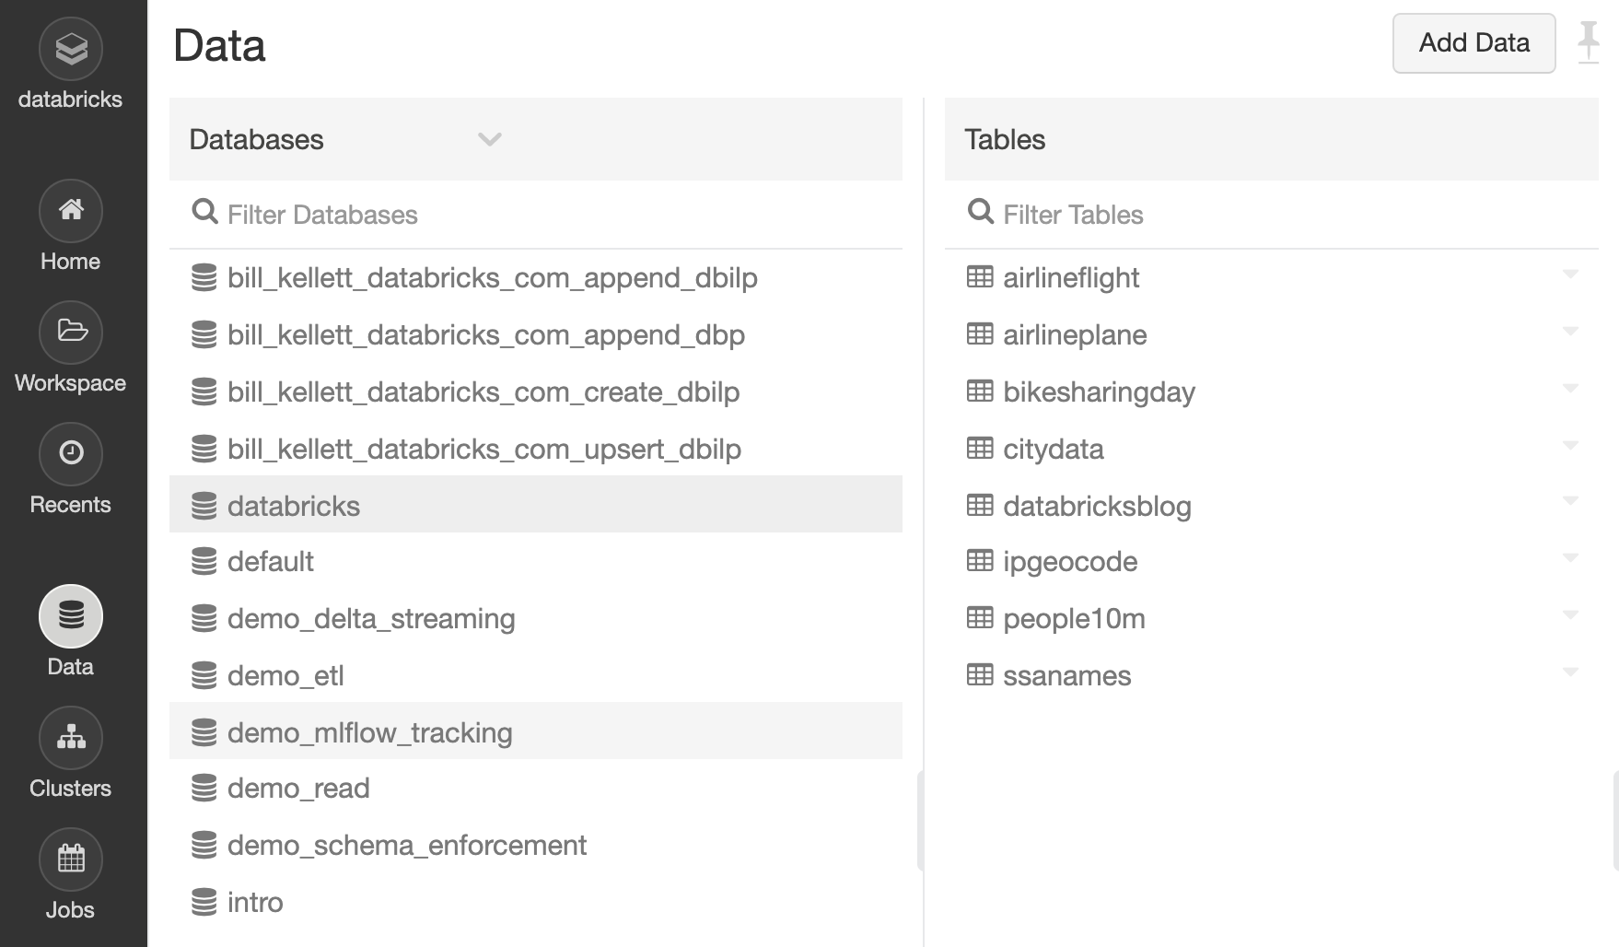
Why is it valuable?
Notes:
The Data tab on the Databricks workspace allows workspace users to browse…
<CLICK> Data Lake databases defined on the workspace.
<CLICK> Users can select a database…
<CLICK> … and browse the contents of its tables. The Databricks JDBC Connector enables users to view and query this same data from any tool that supports JDBC connectivity.

Slide 3
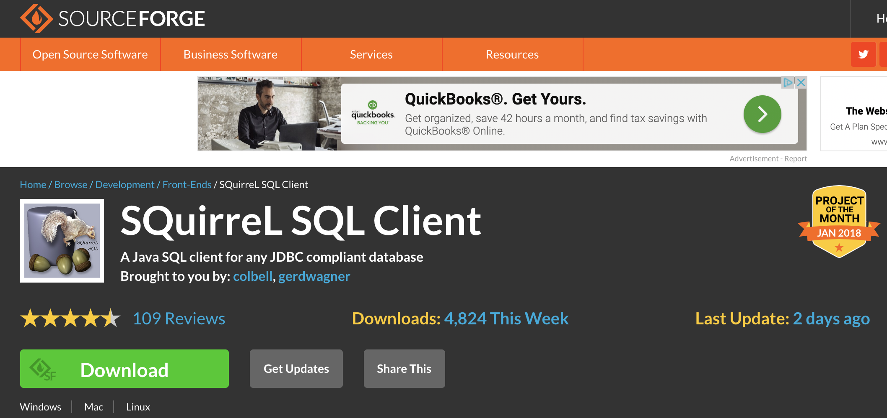
Prerequisite: Install Squirrel
Notes:
In this demo, we’ll be using a free JDBC software tool called Squirrel. To begin, download and install the Squirrel SQL Client. Squirrel works on all popular desktop platforms; just follow the installation instructions.

Slide 4
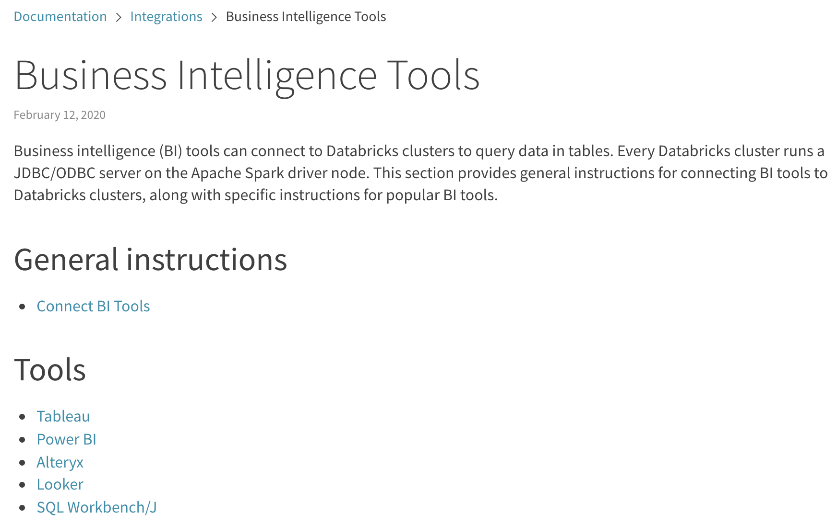
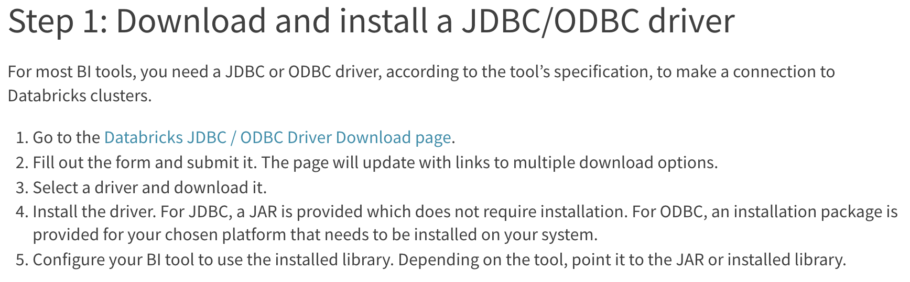
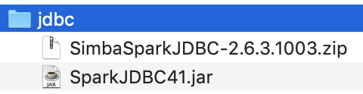
Step 1: Obtain the Databricks JDBC Driver
Notes:
To begin, you must obtain the Databricks JDBC driver. The link to the documentation page shown here is given at the end of this presentation. Click the link to ”Connect BI Tools.”
<CLICK> The link takes you to a detailed instructions page.
<CLICK> Download and unzip the driver file. Place the SparkJDBC41.jar file in any convenient location on your machine.

Slide 5
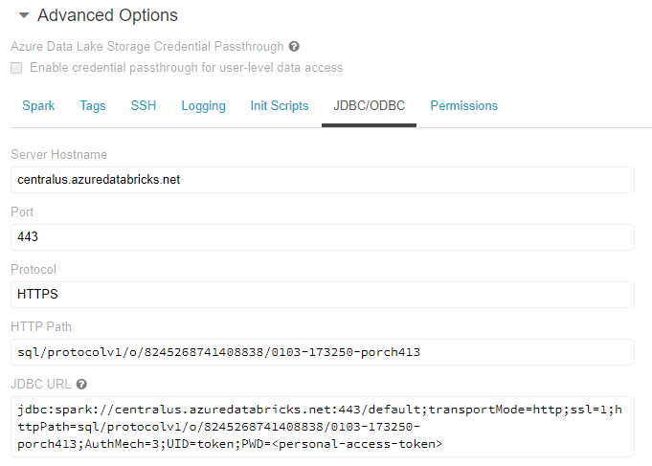
Step 2: Obtain the JDBC Connection String
Notes:
Now open your Databricks workspace. Go to the Clusters tab, and select the cluster you want to use. In the cluster’s Advanced Option section, go to the JDBC/ODBC tab and copy the JDBC URL string. Note that you must replace the last parameter with your actual personal access token, which you can create in the User Settings of your workspace.

Slide 6
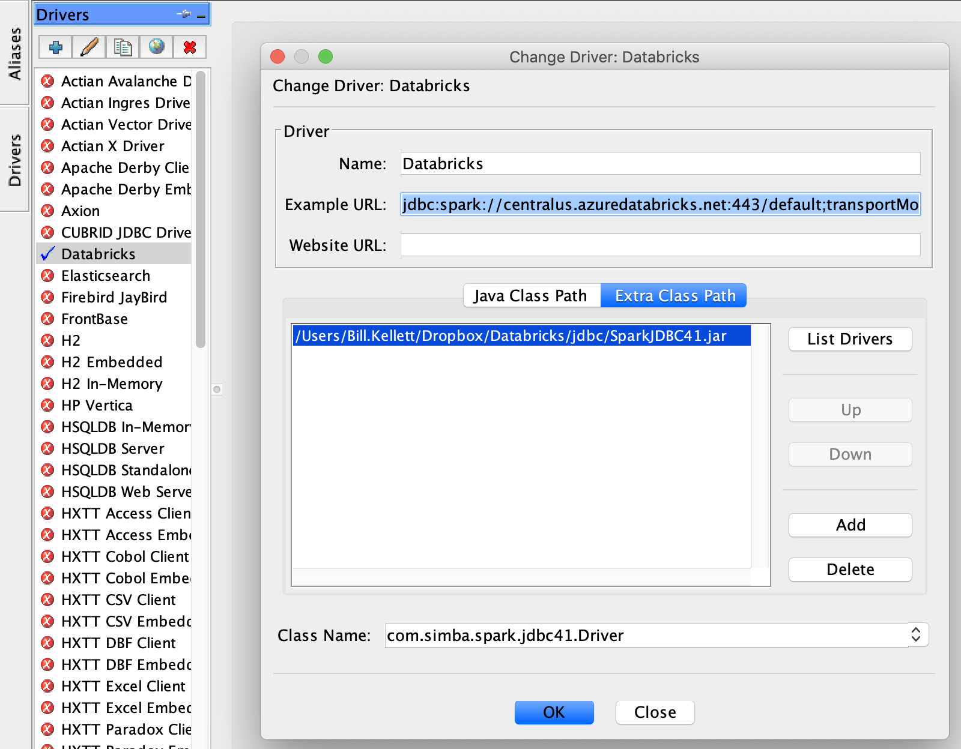
Step 3: Define the Driver in Squirrel
Notes:
Now we are ready to define the driver in Squirrel.
<CLICK 1> Go to the Drivers tab in Squirrel…
<CLICK 2> … and click Add.
<CLICK 3> Give the Driver a name…
<CLICK 4> … and enter the Connection String with your token that you obtained earlier from the cluster’s Advanced section.
<CLICK 5> Go to the Extra Class Path tab…
<CLICK 6> … click Add…
<CLICK 7> … and enter the path to the JDBC driver that you saved earlier.
<CLICK 8> When you click List Drivers…
<CLICK 9> … the Driver class from the Jar file is shown.
<CLICK 10> Click OK, and the driver is defined in Squirrel.

Slide 7
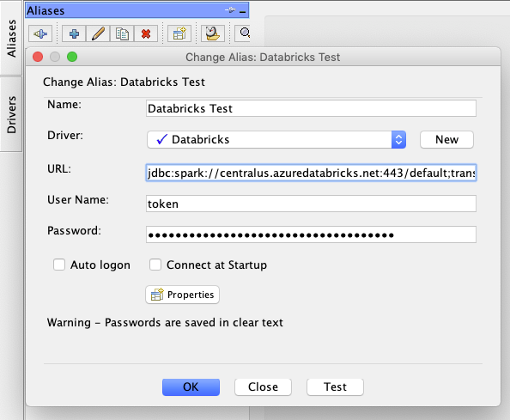
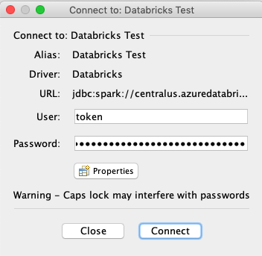
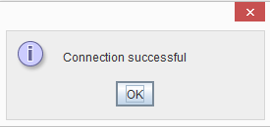
Step 4: Define the Alias in Squirrel
Notes:
Next, we define the Alias in Squirrel. This is the specific information we will use to connect to Databricks.
<CLICK 1> Go to the Aliases tab in Squirrel…
<CLICK 2> … and click Add.
<CLICK 3> Give the Alias a name…
<CLICK 4> … and associate it with the Driver we defined earlier.
<CLICK 5> Now we paste in the connection string obtained earlier from the Advanced tab of the cluster. Remember to add your actual token in the password parameter.
<CLICK 6> Squirrel requires that we re-enter the user ID and token in these fields. The user name is “token”.
<CLICK 7> Now we can click Test...
<CLICK 8> … test our connection to Databricks…
<CLICK 9> … and verify that the connection works.
<CLICK 10> Click OK, and the Alias is defined in Squirrel.

Slide 8
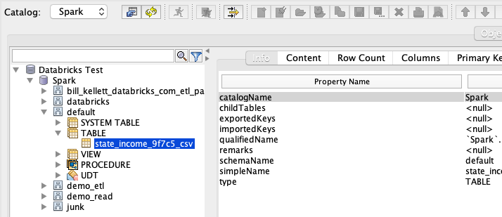
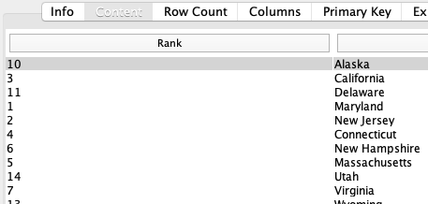
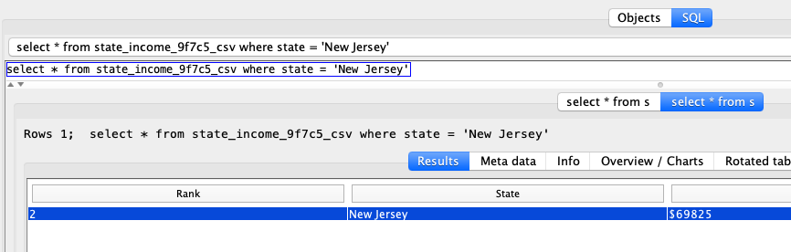
Step 5: Connect to Databricks and consume data
Notes:
Thanks to the Databricks JDBC Driver, We can see our databases and tables…
<CLICK> … view their contents…
<CLICK> … and execute SQL statements against them.
Our demo is complete.

Slide 9
Useful Links
General Instructions for JDBC/ODBC:
https://docs.databricks.com/integrations/bi/jdbc-odbc-bi.html
Specific Instructions for popular BI tools:
https://docs.databricks.com/integrations/bi/index.html
Notes:
Please see these links for further information.
Thank you.

